Slide 1
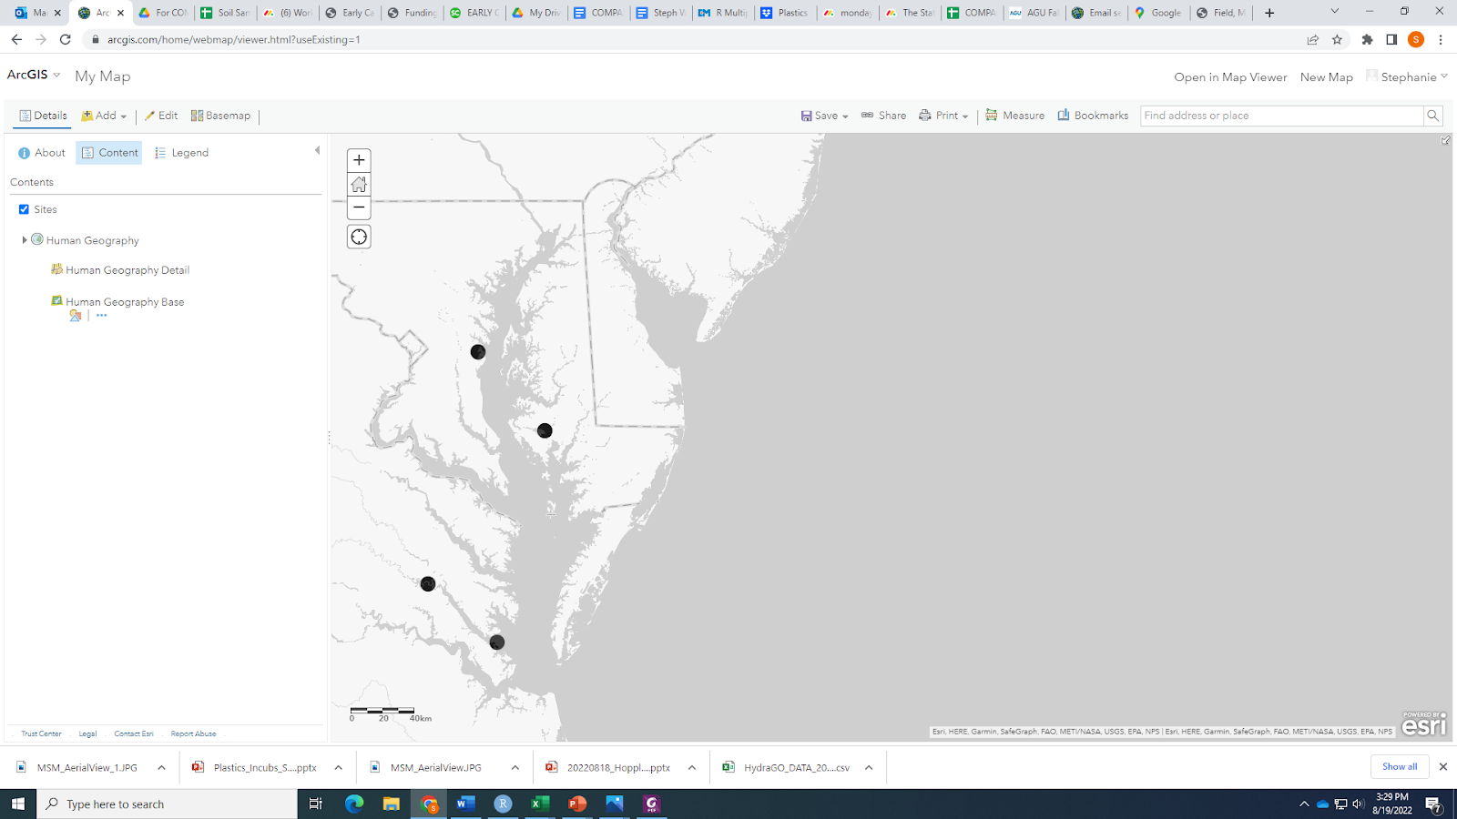

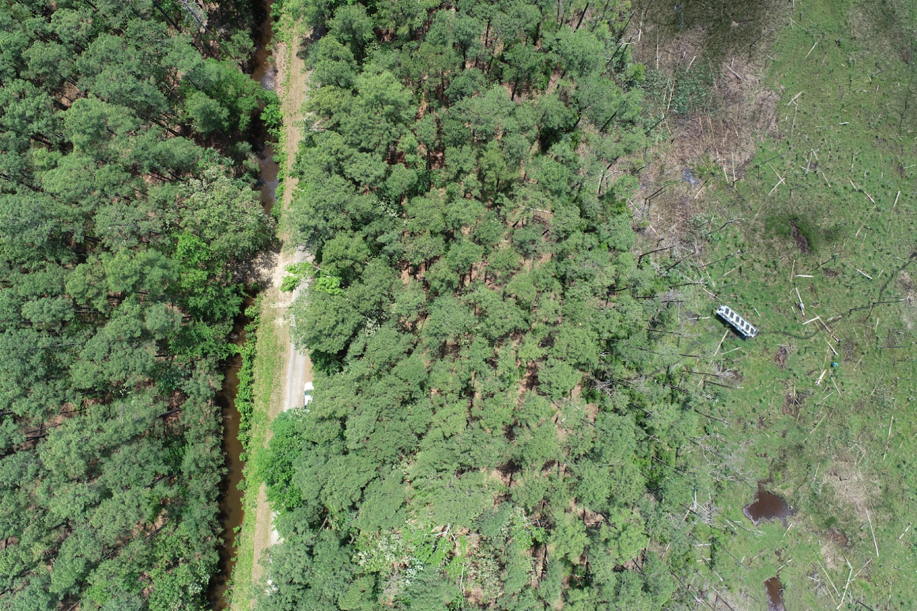
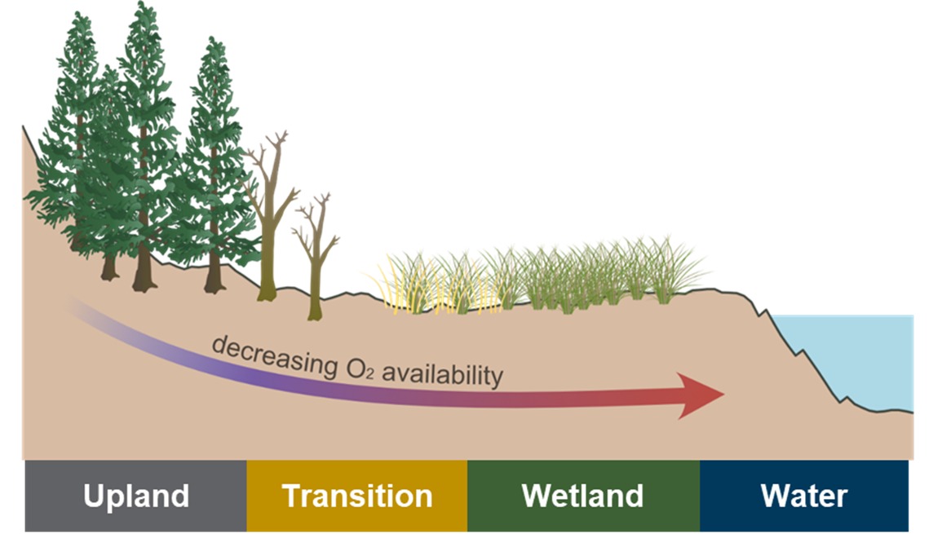
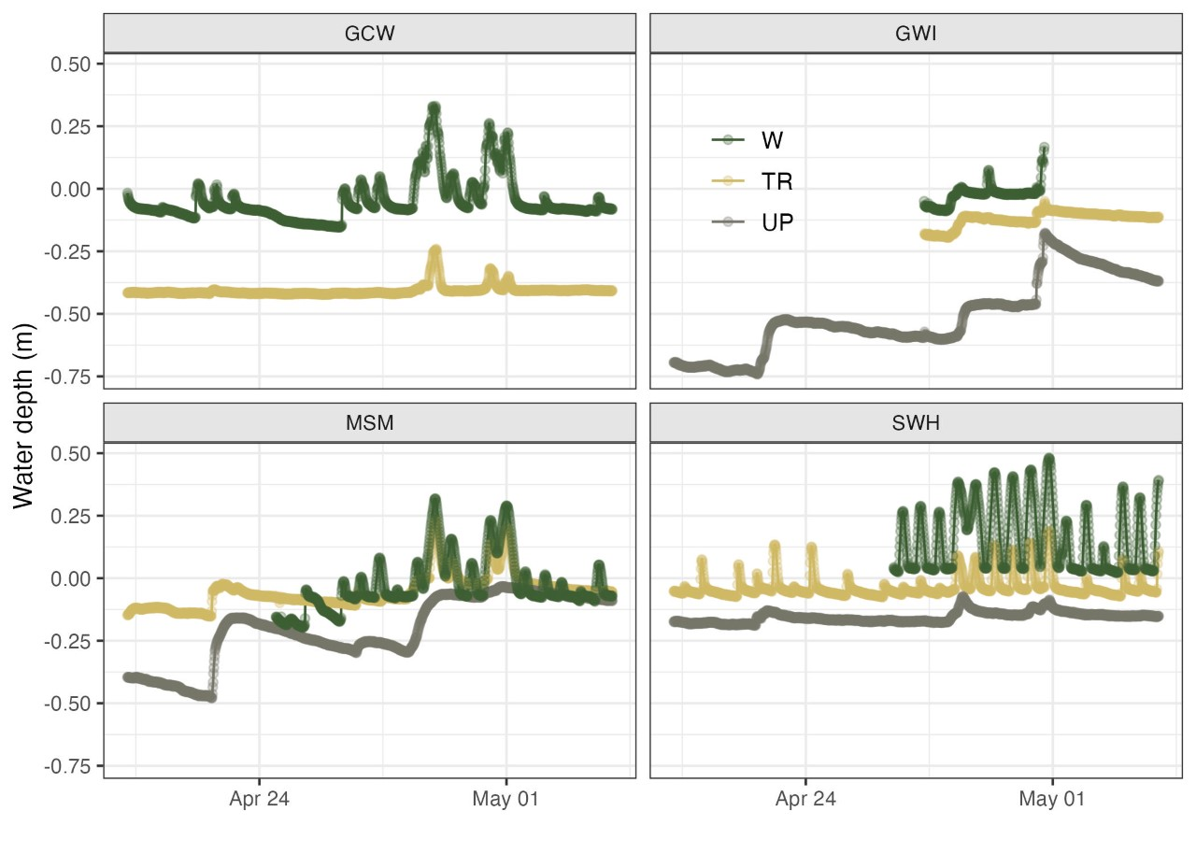
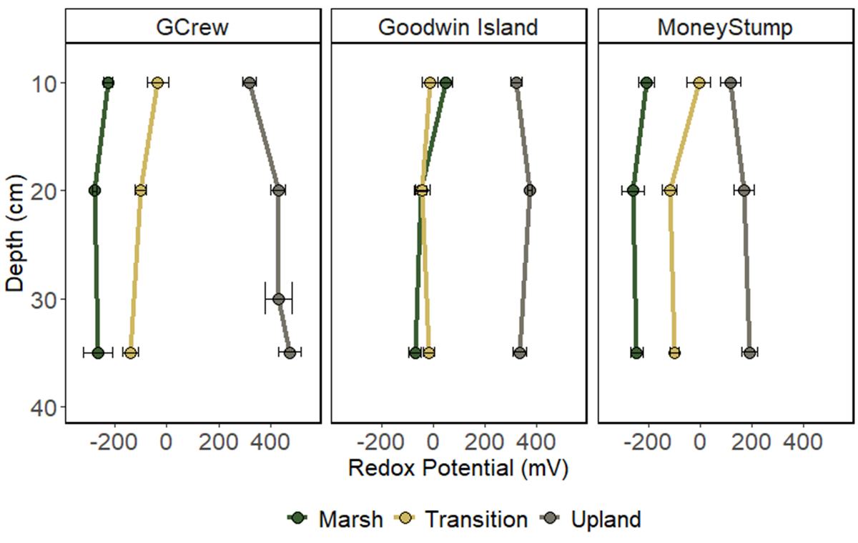
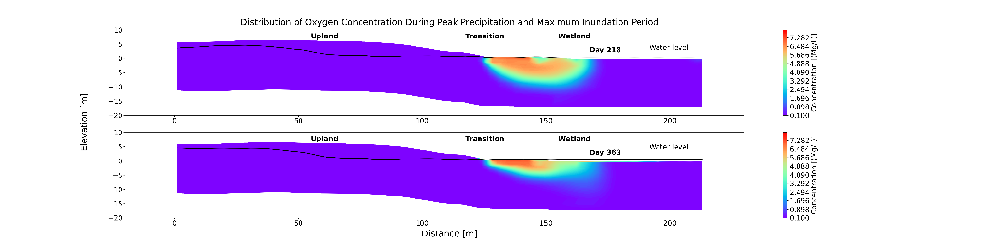
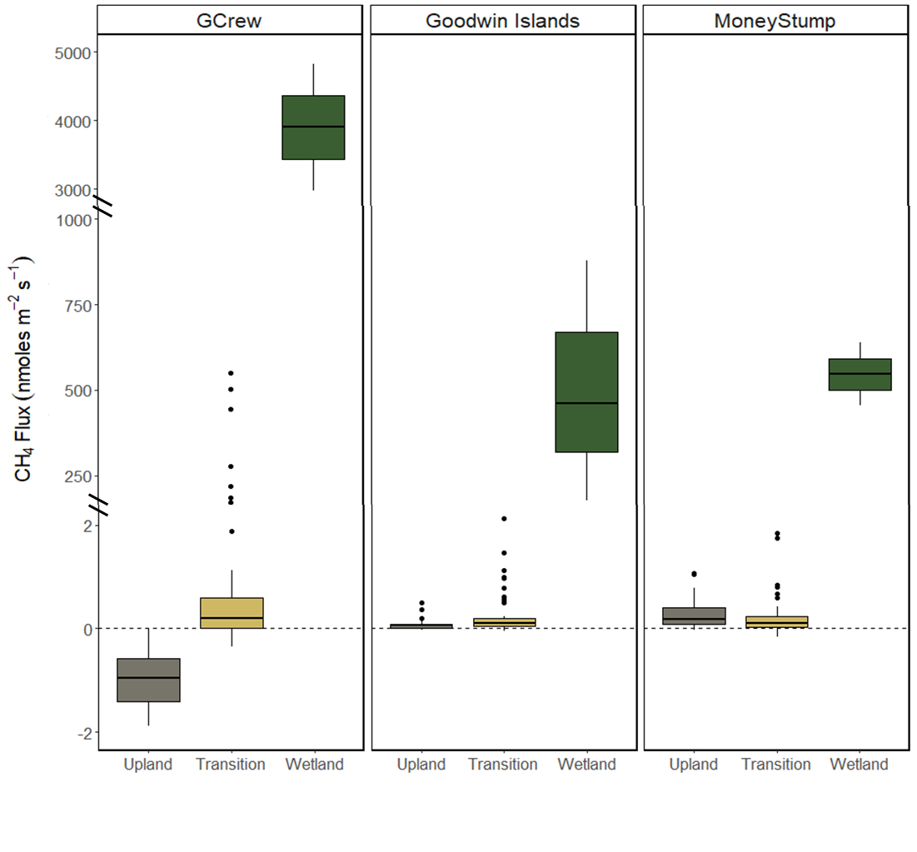
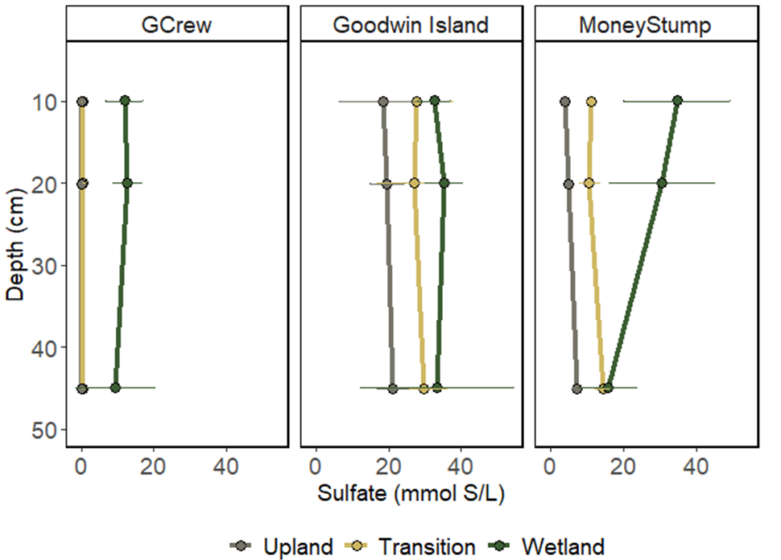

Biogeochemistry and function in soils as they transition from coastal forest to wetland in the Chesapeake Bay
Stephanie J. Wilson^{1*}, Patrick Megonigal¹, Roy Rich¹, Alice Stearns1, Evan Phillips¹, Erin Fien¹, Lani DuFresne¹, Peter Regier², Allison Myers-Pigg², Stephanie Pennington², Anya Hopple², Kendalynn A. Morris³, Nate McDowell², Ben Bond-Lamberty³, Bing Li², Jianqiu Zheng², Xingyuan Chen², Mike Weintraub⁴, Nick Ward², Ken Kemner⁵, and Vanessa Bailey²
¹Smithsonian Environmental Research Center, MD, USA; ²Pacific Northwest National Laboratory, WA, USA; ³Joint Global Change Research Institute, MD, USA; ⁴University of Toledo, OH, USA; ⁵Argonne National Laboratory, IL, USA
Background: Sea level rise drives spatial migration of coastal ecosystems and can lead to the replacement of coastal forests with tidal wetlands. Stressed or dead trees are indicators of forest conversion to wetland, but carbon cycling and soil biogeochemistry are also altered significantly during this ecosystem state change. Biogeochemistry and vegetation shifts may occur on different timescales and influence ecosystem function.
Site | Salinity
Sweethall | 0-2
GCReW | 8-10
MoneyS tump | 8-10
Goodwin Islands | 18-20
GCReW
Money Stump
Hypothesis: There is a hierarchical structure to spatial variation in ecosystem structure and function at the coastal terrestrial-aquatic interface set by: 1) the depth and duration of soil saturation, 2) the abundance of redox-sensitive elements, 3) their interactions with plant traits
Sweethall
Goodwin Islands
Upland
Transition
Wetland
Four (CB) transects from upland coastal forest to tidal wetland established
Continuous monitoring of water, soil, and sap flow across the terrestrial-aquatic interface
Monthly redox and, porewater profiles, greenhouse gas fluxes,
Results
Water level gradient across zones and varying hydrologic conditions across sites
Transition zones are highly variable, creating hot spots and hot moments
This aligns with model results indicating that the distribution of oxygen in transition and wetland regions is significantly influenced by both precipitation and inundation events.
Porewater sulfate concentrations directly linked to salinity and conductivity
Profiles across zones match hydrology and soil moisture
The availability of sulfate will influence soil function, as it a provides more energetically favorable reaction than methanogenesis
Fig.1. Water level overtime across zones at synoptic sites
Fig.4. Porewater sulfate concentration profiles.
CH₄ Sink
CH₄ Source
Transition soils are shifting from sinks to sources of CH₄
Soil function with respect to CH₄ is shifting prior to mass tree mortality
Consistent pattern observed across site salinities and following the hydrologic gradient
These data support that inundation may be more important to ecosystem function with respect to CH₄ than redox sensitive elements.
Fig.2. Distribution of oxygen concentration during two extreme weather events: the largest precipitation event and the strongest inundation event (ATS-PFLOTRAN)
Lower redox potential suggests more reducing conditions
Horizontal and depth gradients driven by hydrology and inundation frequency that alter soil moisture across zones
Fig.5. Soil CH₄ fluxes across synoptic transects.
Take home messages: Inundation depth and duration are a major drivers of structure and function at the coastal terrestrial aquatic interface. Changes in soil biogeochemistry and vegetation during marsh migration occur on different timescales. This asynchrony will influence ecosystem function and is critical to the framework to how we will accurately model these systems. The synoptic site monitoring data will serve as model inputs to better predict changes across the terrestrial-aquatic interface.
Fig.3. Redox potential profiles across zones.
Notes:
• Contact Digital Duplicating (375-2969, http://digitalduplicating.pnl.gov) to order poster printing and finishing services for your completed poster design.
• Remember to have your poster cleared for public display/distribution through the ERICA Information Release system (http://erica.pnl.gov).

